Slide 1

SUMMER INTERNSHIP 2019
ABES ENGINEERING COLLEGE
Presented By: Aman Chauhan (2018BIT1052)
Project Name: WORD GAME USING TKINTER

Slide 2
INTRODUCTION TO PROJECT
GUESS THE UNKNOWN WORD
Made with PYTHON
Word game using GUI in python
Guess the unknown word and answer it
Use concepts of LISTS in python
Use TKINTER module for GUI
Word can be added and removed

Slide 3
ABOUT PYTHON
Created by Guido van Rossum and first released in 1991
Interpreted, high-level, general-purpose programming language
Known as "batteries included" language
Interpreters are easily available
Use the concept of OOPs
Dynamically typed and Garbage-collected
Easily readable language , use English keywords

Slide 4
FEATURES OF PYTHON
Easy to read, learn and use
Use Automatic Memory Management
Interpreted Language
Cross-platform Language
Free and Open Source
Object-Oriented Language
Large Standard Library
GUI Programming Support

Slide 5
ABOUT PROJECT
IDE USED:
Visual Studio Code
Jupiter Notebook
Module Used:
Tkinter Module
Random Module
TKINTER MODULE:
Implement the GUI using python
Most commonly used for GUI in python
fastest and easiest way to create the GUI applications in python
Provides a powerful object-oriented interface

Slide 6
ALGORITHM / APPROACH
Imorting all the modules and functions from module
import tkinter
from tkinter import *
import random
from tkinter import messagebox
BACK-END WORKING
Create two lists
Store random number in num and choose random word from list of jumbled words
Create working() as function to map jumbled word in label
Create checkans() as function to check that answer entered by user is correct or not.
Create res() function to reset the label value when one answer is given or when reset button is pressed
FRONT-END WORKING
Define the tkinter and provide attributes to tkinter
Define label box ,which show the jumblled word on the screen
Define entry box ,where user enter the answer
Create a button which check the entered value
Create a button which reset the label
Call working() function and run mainloop

Slide 7
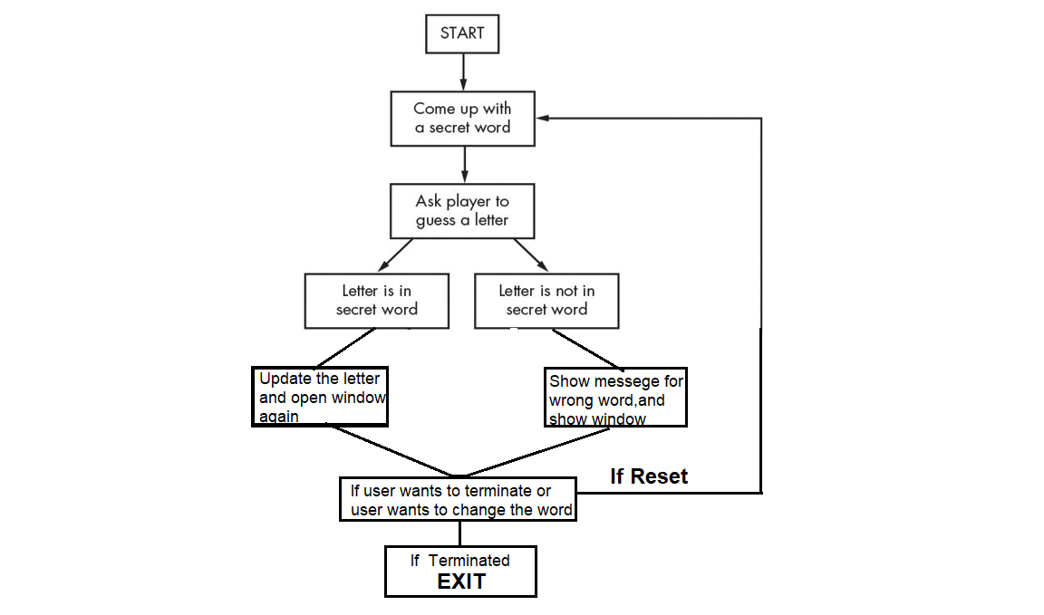
FLOWCHART

Slide 8
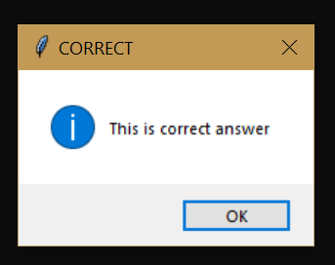
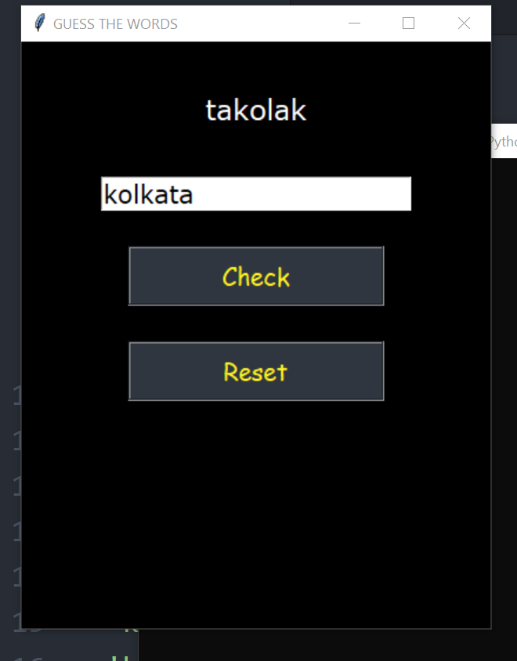
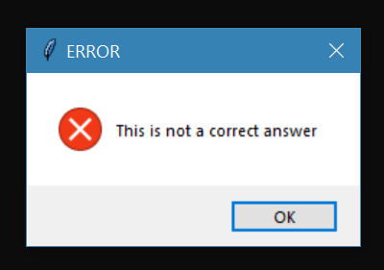
SAMPLE SCREENSHOTS/OUTPUTS
When word is correct:
When word is wrong:

Slide 9
THANKS A LOT EVERYONE FOR YOUR TIME

